Slide 1




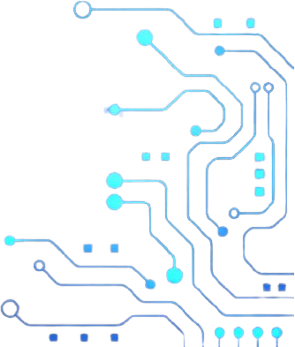
Departmental Hackathon:
ENTC Edition
Team Name: QuadCore
Solution Name: HydroSense – Smart Solar Powered Irrigation System
By I2IC TPO and EESA VIIT
Notes:
1.7.2013
‹#›

Slide 2

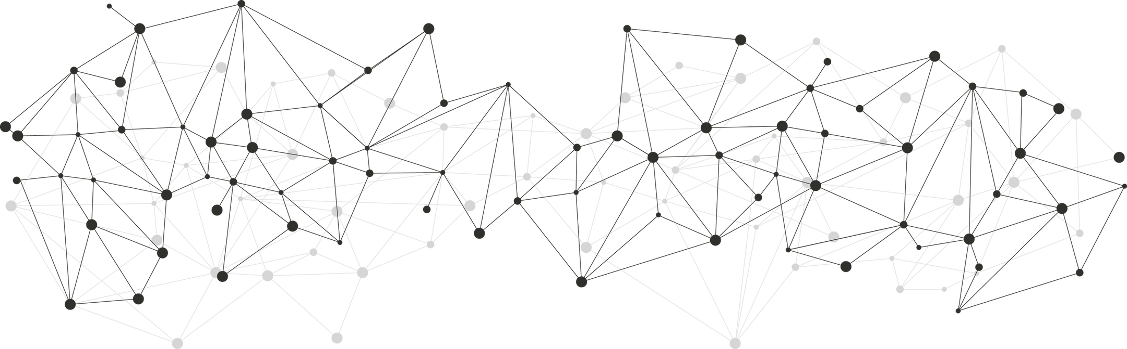
Team Member Details
Team Name :
QuadCore
Team Members : 4 | 1 (Leader) | 2 | 3 | 4
Name : | Atharva Vinayak Maslekar |  | Atharva Rajendra Joshi | Manas Girish Kulkarni
Atharva Santosh Suryavanshi
Notes:
1.7.2013
‹#›

Slide 3


Team Member Details
Atharva Maslekar
Atharva Suryavanshi
Notes:
1.7.2013
‹#›

Slide 4

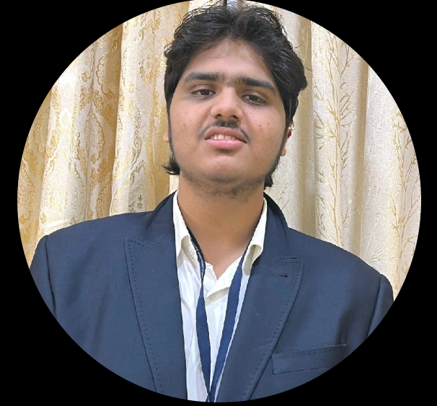
Team Member Details
Manas Kulkarni
Atharva Joshi

Slide 5
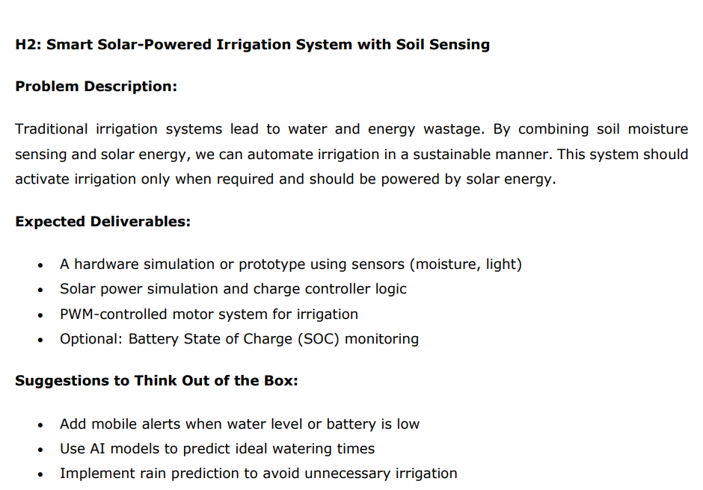
Problem Statement
Notes:
1.7.2013
‹#›

Slide 6
Problem
🌍 Agriculture in water-stressed regions suffers from inefficient irrigation and water wastage.
💧 Overwatering and under-watering due to manual monitoring harms crop yield.
🕹️ Farmers lack affordable automation tools for water management.
⚡ Unreliable power supply in rural areas limits the use of electric irrigation systems.
Notes:
1.7.2013
‹#›

Slide 7
Proposed Solution
🌞 Solar-powered system for sustainable energy usage
🌱 Real-time soil moisture monitoring using sensors
🔁 Automatic motor control via Arduino UNO & L298N
📉 Reduces water wastage by irrigating only when needed
📲 Bluetooth integration for live monitoring
🔔 Buzzer alert when motor activates
🛠️ Simple, modular, and scalable setup
Notes:
1.7.2013
‹#›

Slide 8
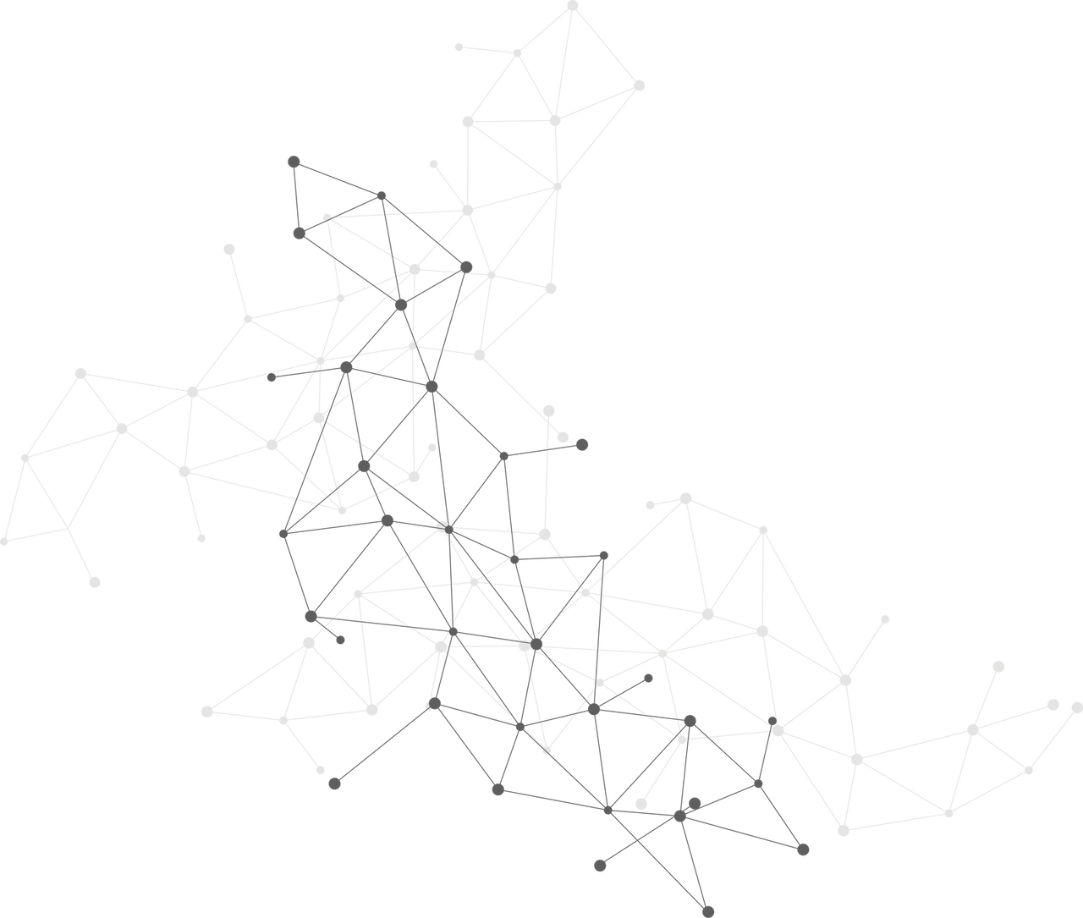
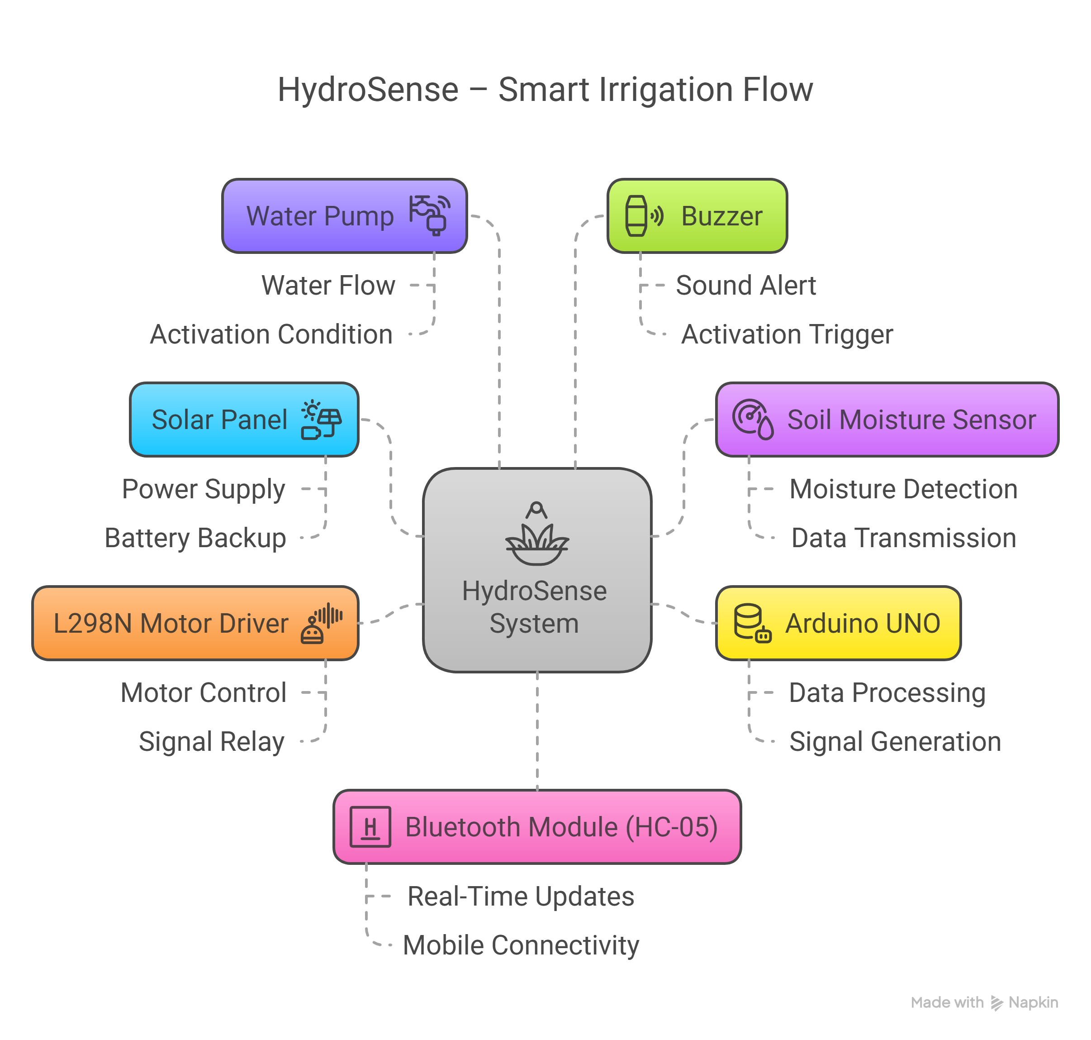
Architecture / Block Diagram
Notes:
1.7.2013
‹#›

Slide 9
Architecture / Block Diagram
Notes:
1.7.2013
‹#›

Slide 10
Tech Stack
🧠Hardware:
🔌 Solar Panels (2 × 1.5W) – Power supply
📟 Arduino UNO – Main microcontroller
🌱 Soil Moisture Sensor – Detects soil dryness
🔀 L298N Motor Driver – Controls the water pump
🚿 Water Pump – Delivers water based on sensor data
🔊 Buzzer – Alert when pump is activated
📡 HC-05 Bluetooth Module – For wireless data transmission
💻Software:
💬 Arduino IDE – Code development and uploading
🔢 C/C++ – Programming logic for automation
📱 Serial Monitor / Bluetooth Terminal App – Real-time status monitoring
📈 Microsoft PowerPoint & Word – Documentation and reporting
Notes:
1.7.2013
‹#›

Slide 11
Impact And Feasibility
✅ Impact:
💧 Water Conservation: Reduces wastage by supplying water only when soil is dry
🌱 Supports Sustainable Farming: Promotes eco-friendly practices with solar energy
📉 Reduces Manual Labor: Automates irrigation, saving farmers time and effort
📊 Data-Driven Decisions: Real-time moisture data helps farmers make informed choices
🌎 Scalable Solution: Can be implemented on small farms or scaled up for larger fields
🧩 Feasibility:
🔋 Powered by Solar Energy – Operates independently in rural areas without grid power
💸 Low-Cost Components – Uses affordable sensors and modules like Arduino, HC-05
🛠️ Easy Assembly – Simple wiring and coding make it DIY-friendly
🔁 Modular Design – Components can be upgraded or replaced easily
✅ Tested & Functional – Working prototype built and verified under real conditions
Notes:
1.7.2013
‹#›

Slide 12
THANK YOU !
By I2IC TPO VIIT
Notes:
1.7.2013
‹#›

